Slide 1

SIT757 Presentation- The ClayTOWN
Tong-Chang Wu
213288591

Slide 2
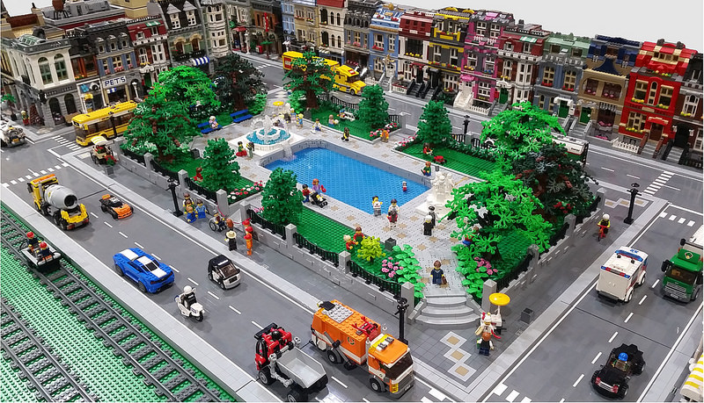
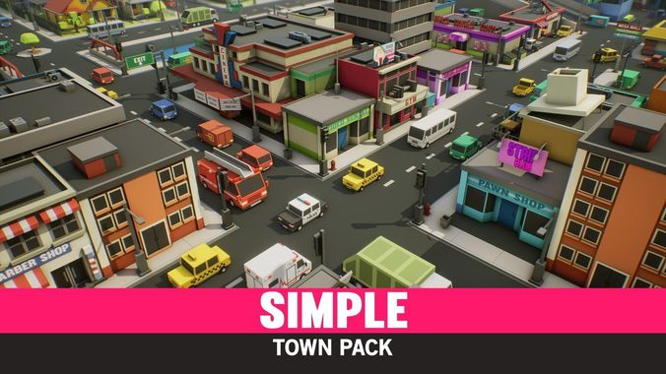
Introduction
Notes:
In this folio, I am choosing project “Claytown” as my concept, based on PC Virtual reality to perform this game. Also, targeting on children under 8 years old. I am using Virtual Reality to elicit children’s creativity to build a small town in a virtual world by himself. This app could also make the children learn some simple English words or colors, hence to achieve simple education with full of fun and enjoy of the game.
To design a simple, and easy game is one of important concept in this project. The other important concept is easy education stuff within the game. So, children can easily learn from it in their subconscious while in the game. Also, it might arouse their creativity to build the town in the way they like. It might look way different in general, but it might show us the different view from how the town will be like.
My concept was coming from the figure in the powerpoint, 3Dmax town simulation and the Lego town. For these scene model was just a sample model for the town construction planning. But, for my prototype allows user to learn, also have the immersion of experience in the VR environment.

Slide 3
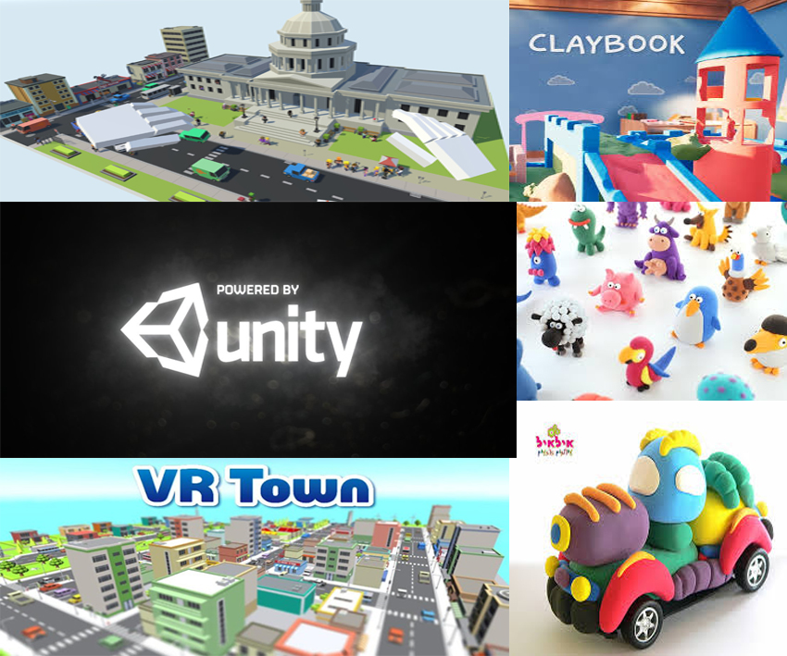
Moodboard
Notes:
So here is the moodboard, my project will be creating by unity. And for 3d assets will be creating by 3dmax. As we can see in the figure. My project will be like a town made with clay also with some simple educational thing in the project which is learning colors and English name of each models.

Slide 4
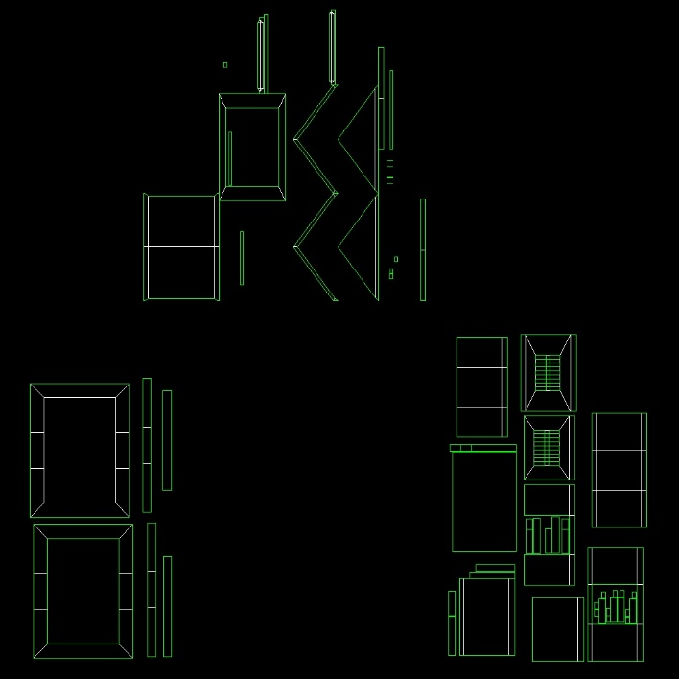
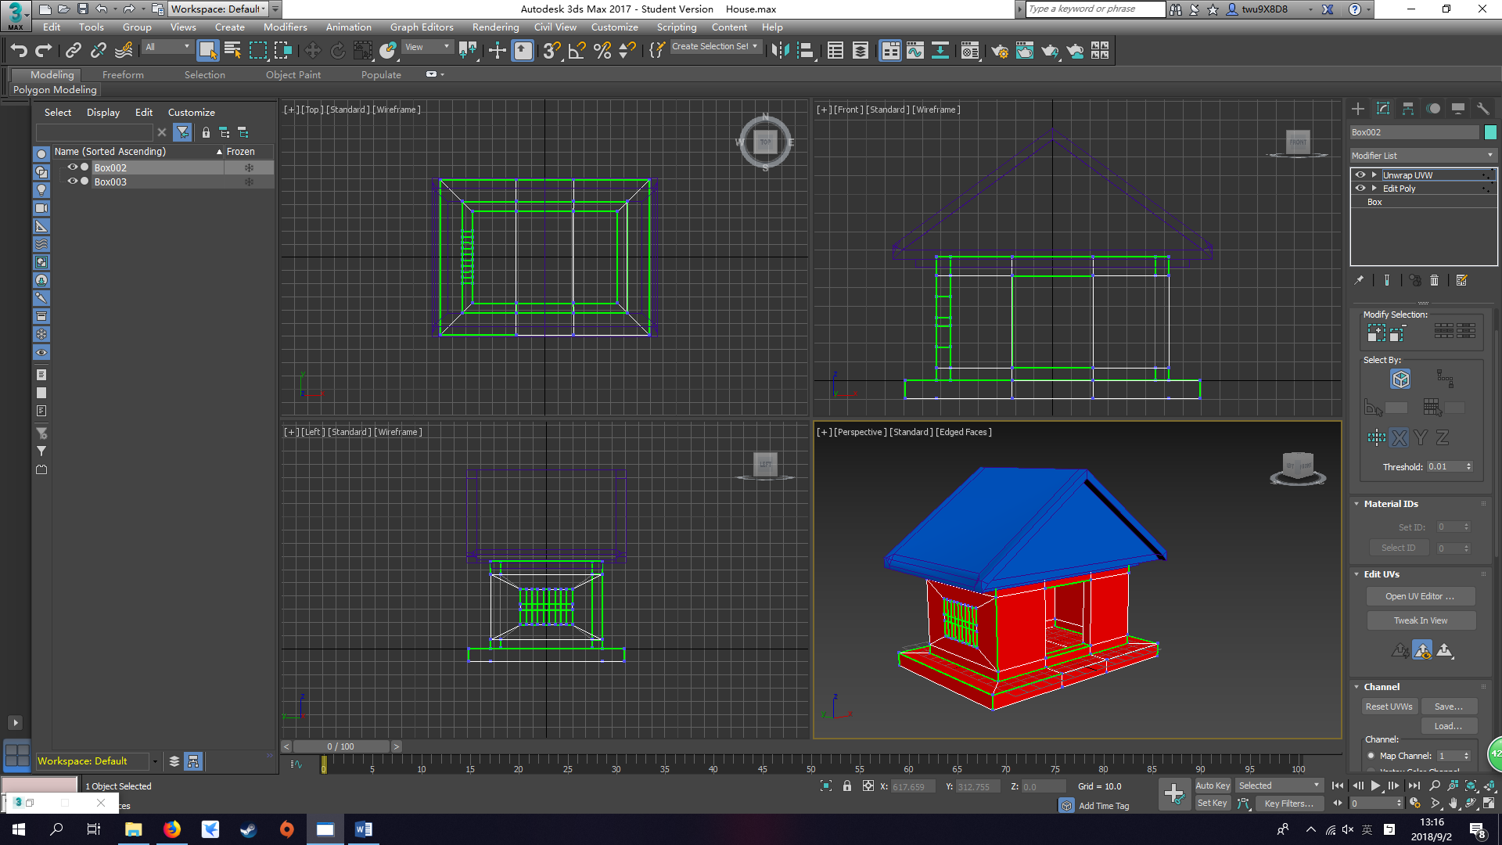
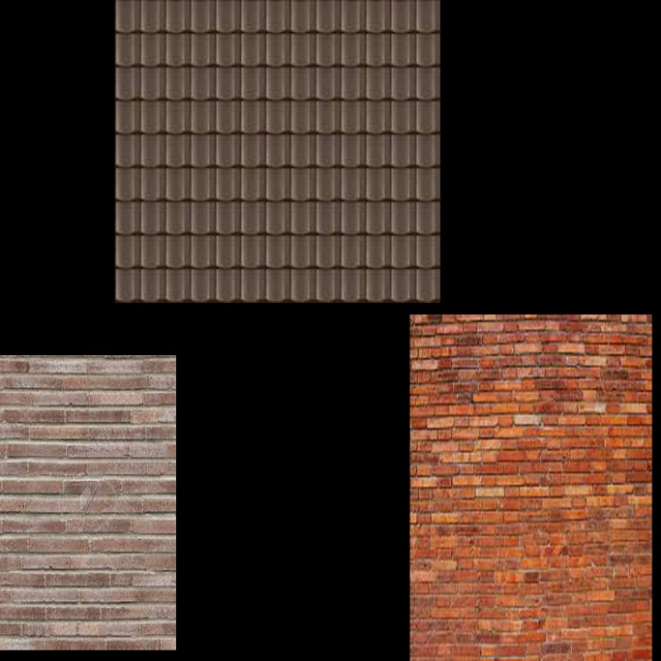
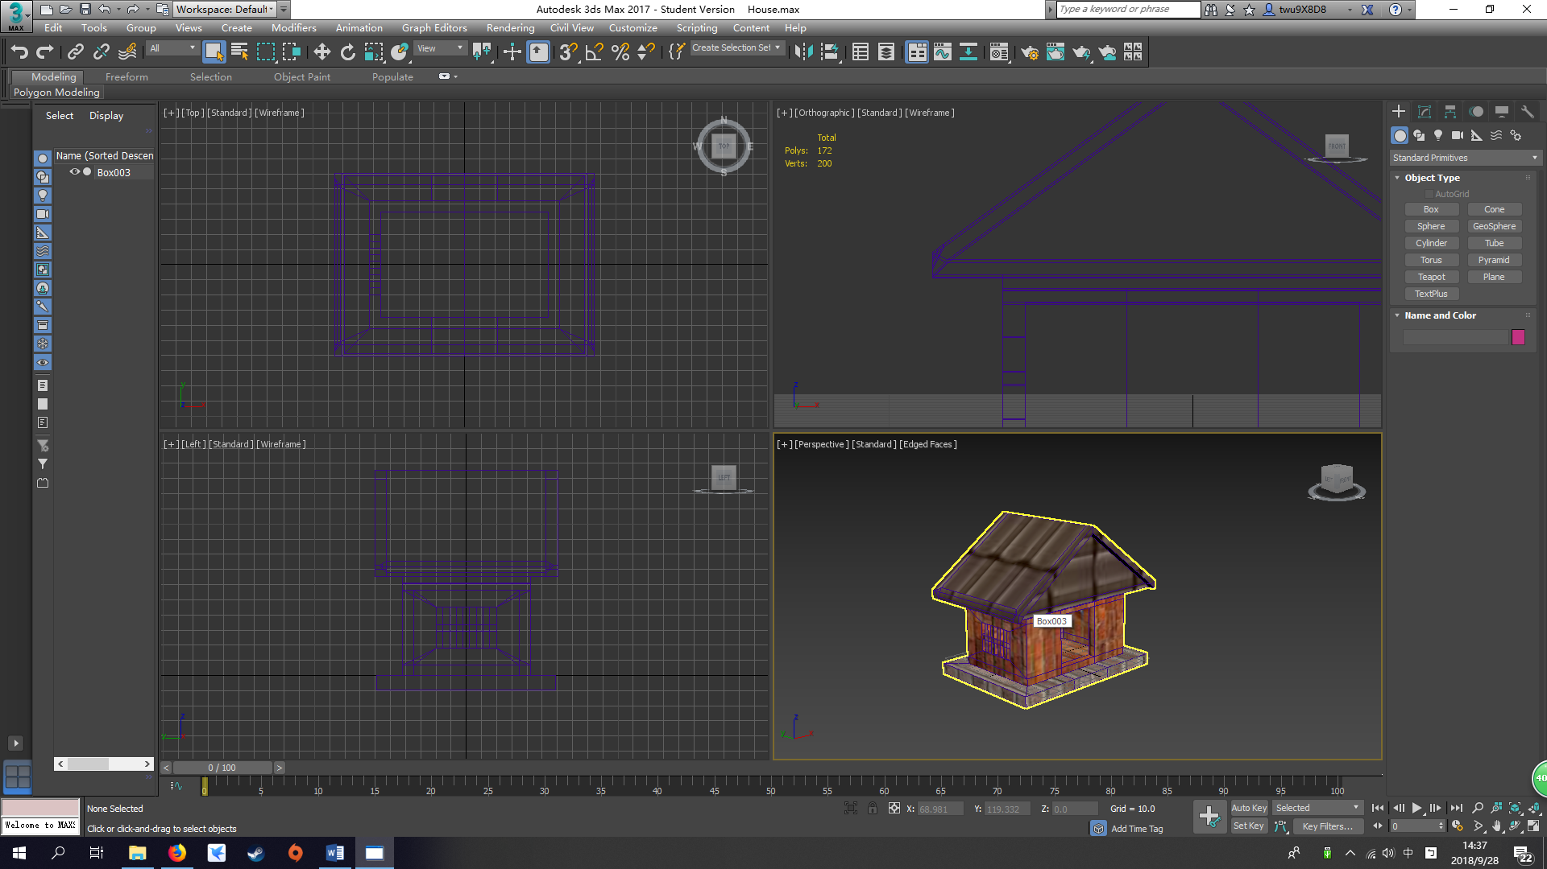
House
Notes:
As my first model creation, I was having a lot problem and take a lot of time creating this model. When I was creating the roof and the body, I found out that I didn’t cut some of the polygon into 3 or 4 sides. Therefore, when I use UVW function to spread the UV in the way I wanted. it took me more time to deal with each side and polygons. Eventually, I found a video 3DS MAX UV Mapping / Unwrapping Tutorial super fast & easy by JBGameStudios(2015) that talks about how to use UVW. In the first folio, we can see the UV map and textures are a mess. So, I recreated a UWV map for house. As we can see the picture on the right which is my final version of the house. And on the left hand side is the before and after for the UV map.

Slide 5
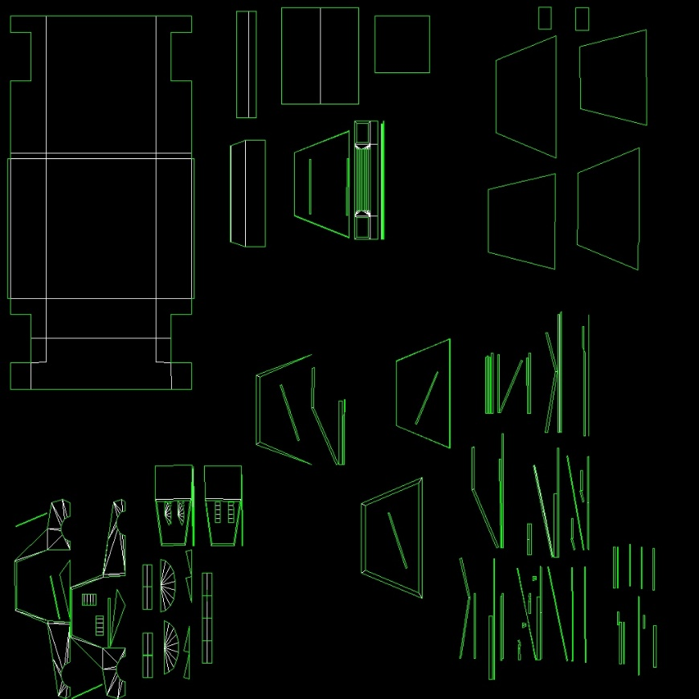
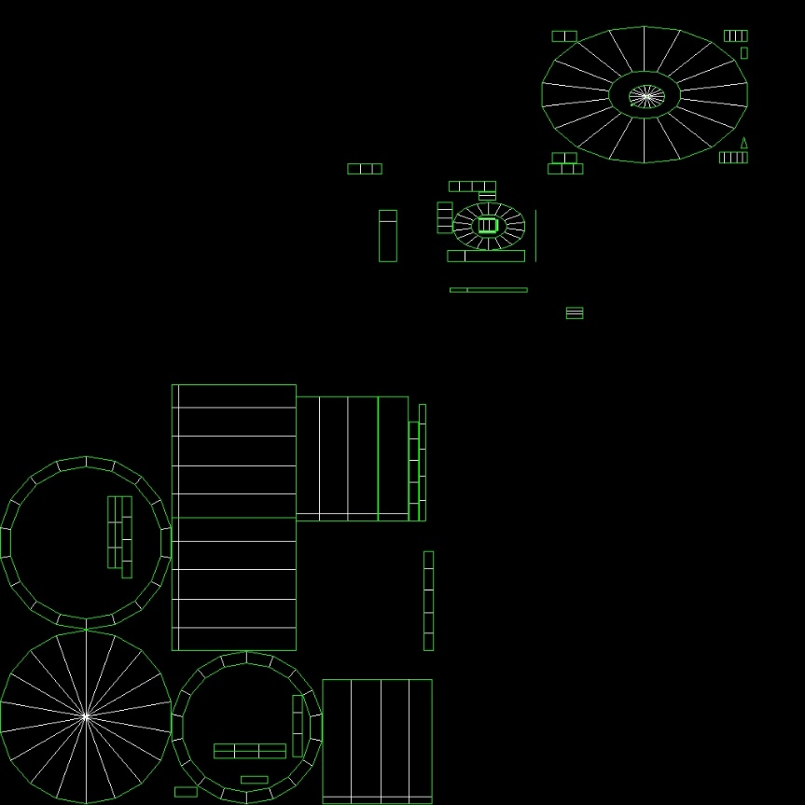
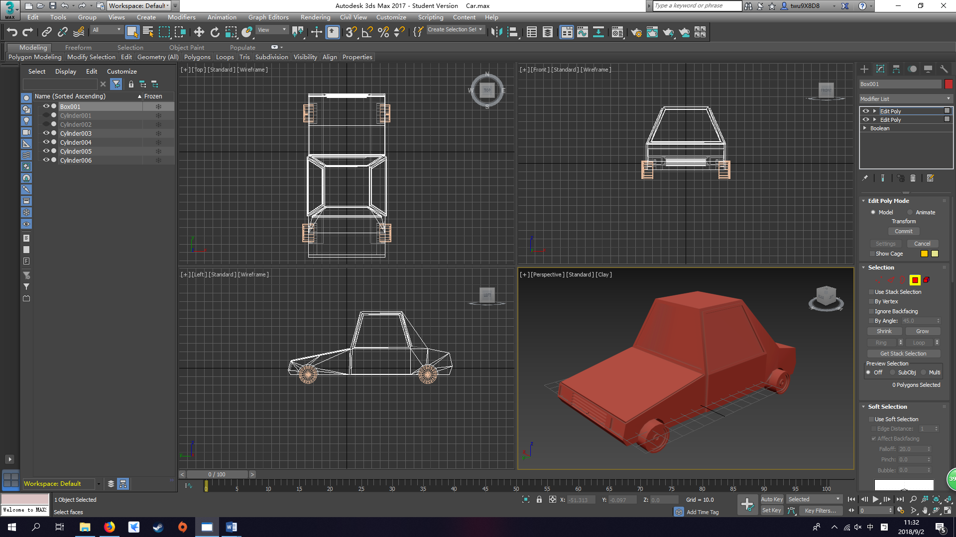
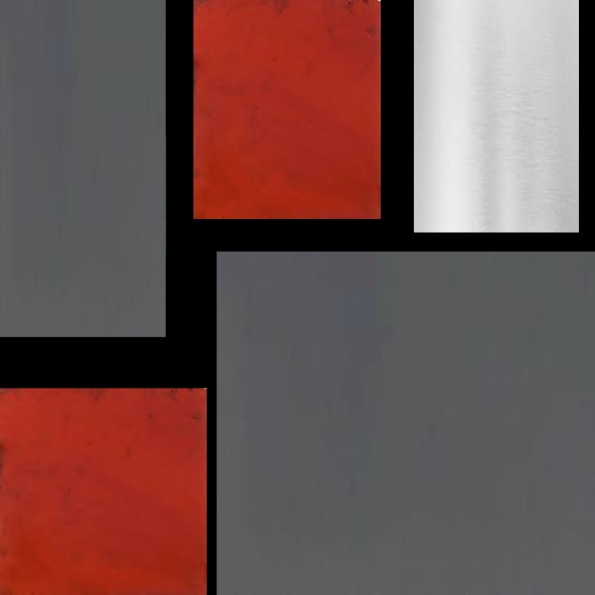
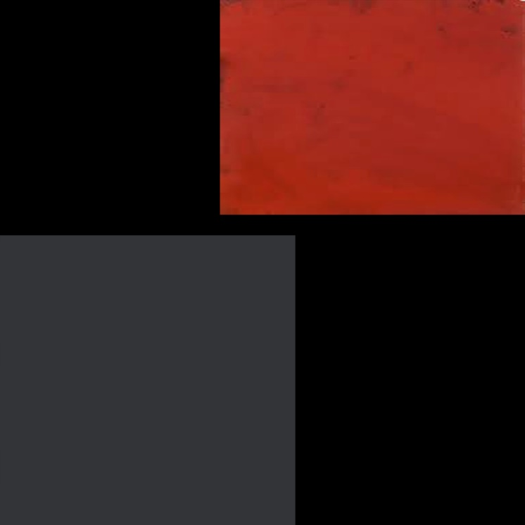
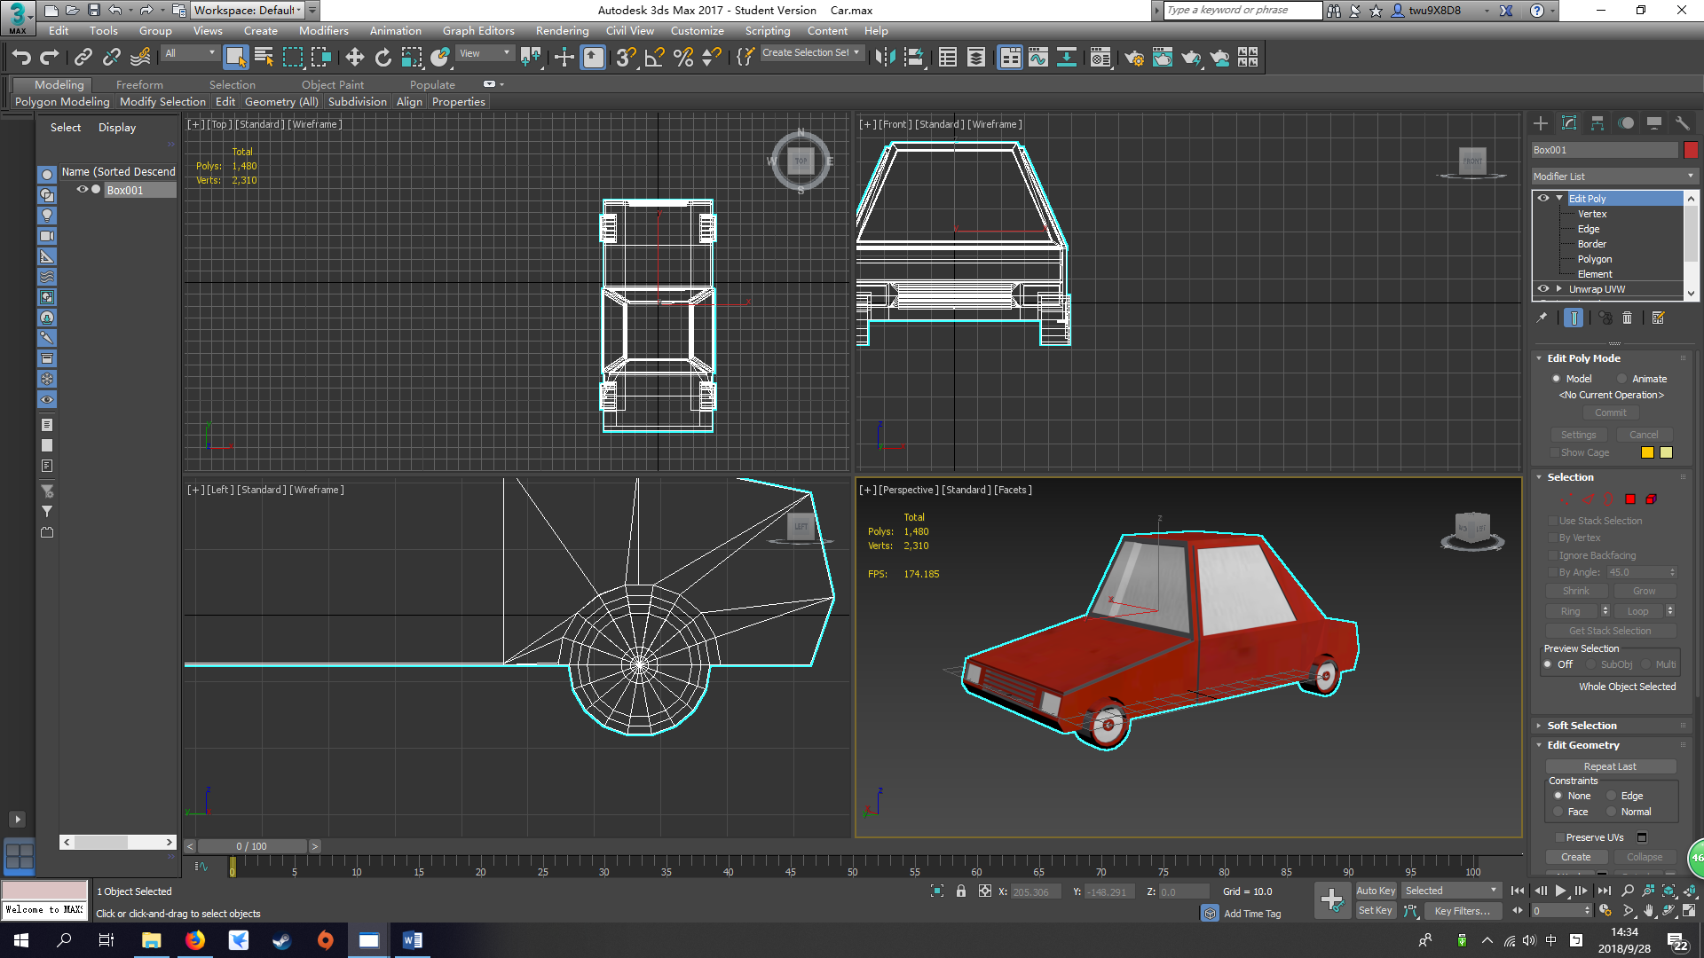
Car
Notes:
I started creating the car body first by using what I learned from the class, as we can see the picture below, I was trying to make a tyre whole from the car body. But I didn’t know how to do it because the 3d Max in my house is 2017 not 2016. Therefore, I asked my friend also in the video Boolean Subtract 3ds Max 2017 by GameDesignDude (2017) about how to use Boolean function to achieve my purpose. While I am creating for the car body, those very detail part like the inlet of the car and those head light at the front took me a lot of time to create it. I have to make sure the vertexes are welded without any cap. After I applied my tyre on to the car body, I connect the line at the middle of the car and chose the vertex for half the car and delete. Therefore, I could use symmetry function to create the other side with the tyre hole and tyre that been created on one side. We can see the UV map in the content. The before and after for the UV map and model.

Slide 6
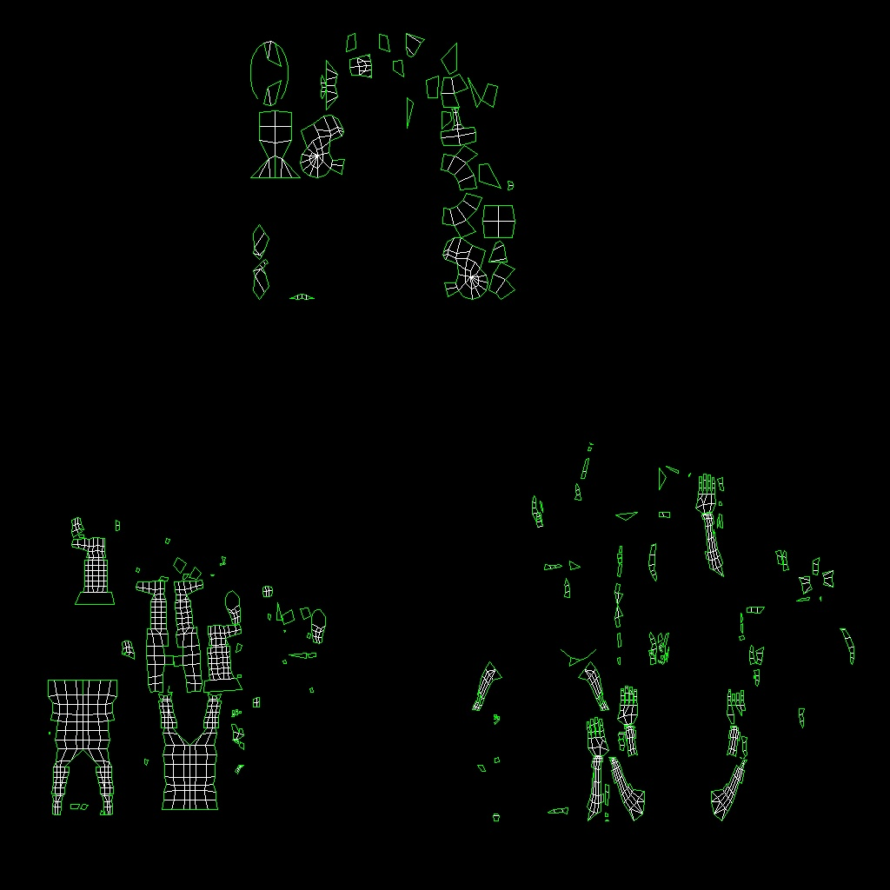
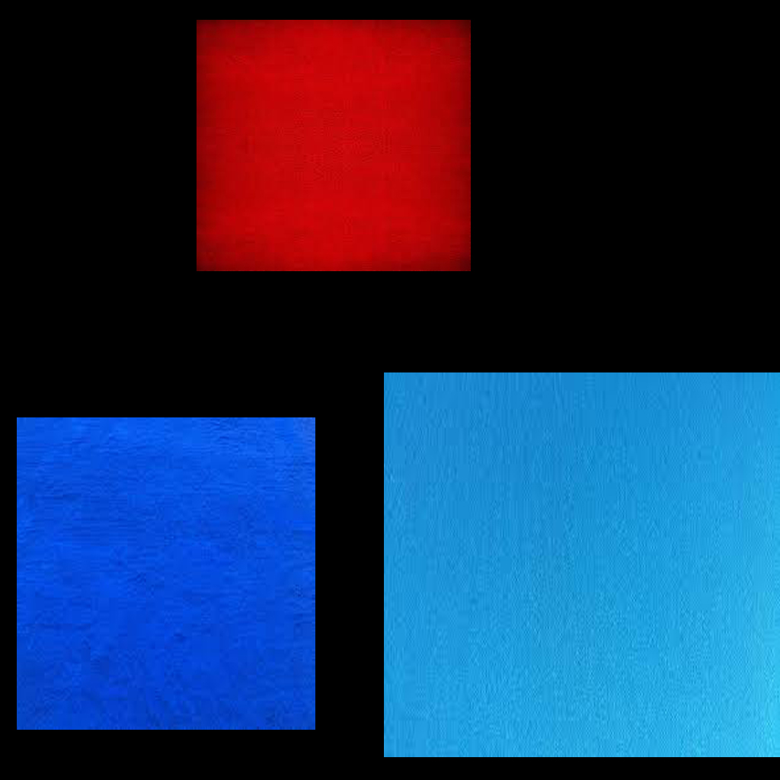
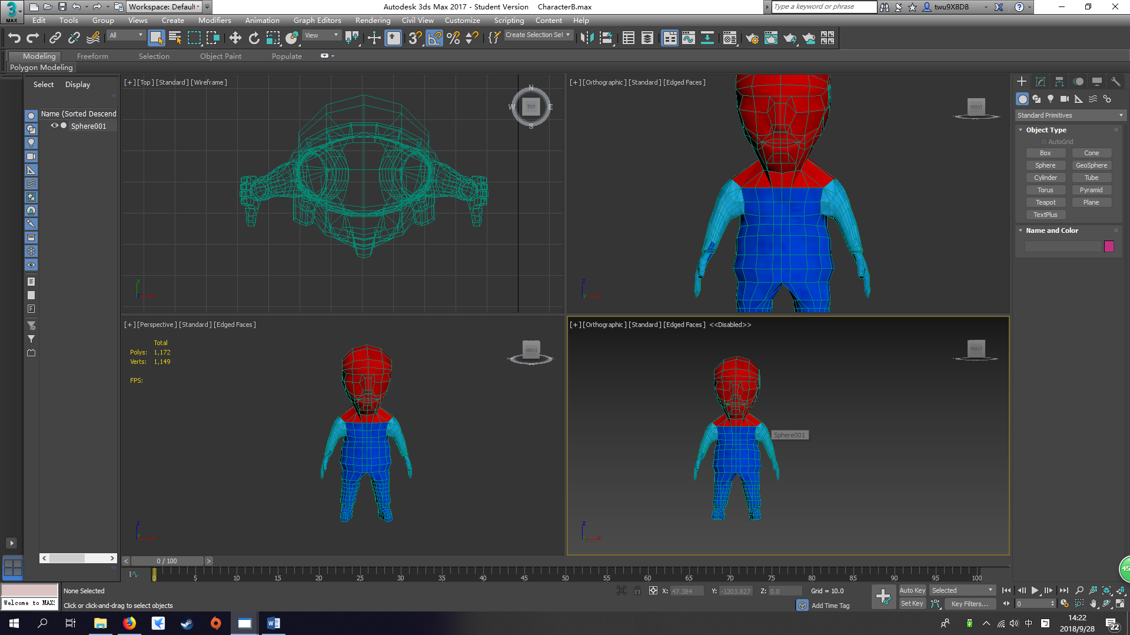
Character
Notes:
For the character, I started creating from the body then arm, foot, hand, shoes then head. While I am creating arm and foot. I’ve encounter some of the vertex couldn’t be weld. So I use edge faces mode and half transparency mode to find the problem. The problem was for each object like arm and foot their polygon that should be remove before attach. Therefore, I can weld those vertex together. Mostly, using symmetry to just doing half side of the character, so the computer will finish the other side for you. The hardest part is creating the head, I started with a sphere, and using cut tool to cut the contour out. But is very hard to do it which took me 10 hours in total to cut all these contour out. On the left hand side, there is the UV map before and after for the character.

Slide 7
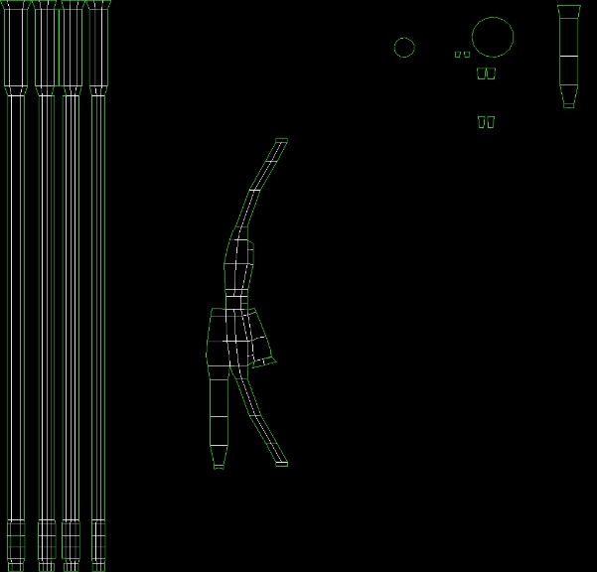
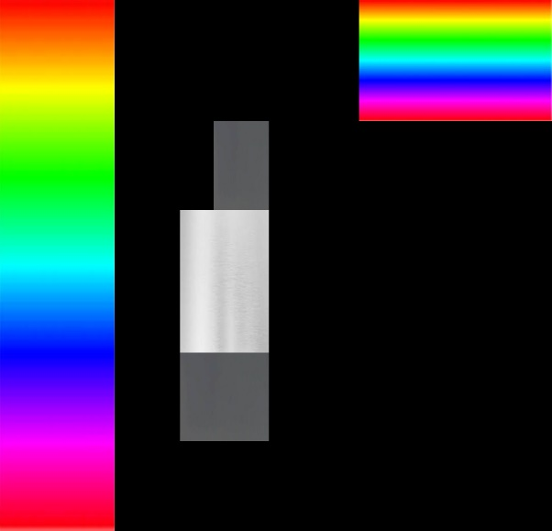
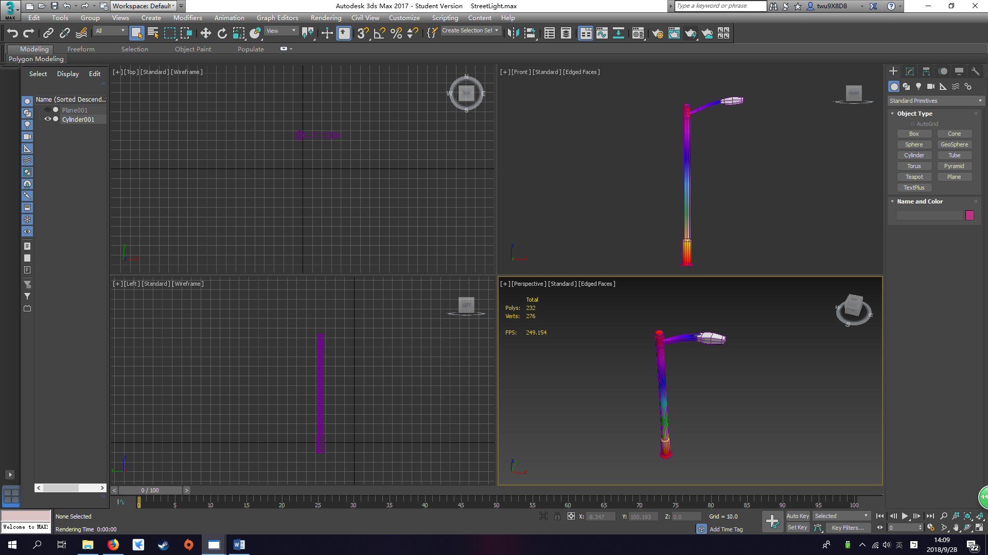
Streetlight
Notes:
I started created a cylinder for the bottom of the object, and drag it up with some adjusting. Then, while I am creating the light part. I’ve encounter some problem which is that how to get a cylinder into a 6 sided object. Therefore, I have asked my friend about it. And he taught me connect 4 side together and again. Then, use the adjusting tool to adjust it to closely to the circle. Then, I and extrude from the body to make the light model. On the left hand side, there are before and after for the UV map.

Slide 8
REFLECTION
Notes:
About 11 weeks of learning and experience the project development, content creation for Virtual reality is ending soon. Overall, I am satisfied with the completion of the theme development task that I have chosen, and the learning process is also very pleasant. The portfolio also meets my own expectations.
I have experienced some difficulties problems, but through my exploration and online learning, I quickly solved them. In the process of the whole project, I considered the modelling part to be a relatively difficult part. In the process of modelling at the early stage, the effect of making the model was always different from the actual reference images. It may be related to art foundation and modelling habits. After that, in the middle of the semester, I gradually mastered the essentials and learned the skills of modelling and mapping. However, the time management and audio management have been affected due to the previous proficiency problems. Didn’t use sufficient time to undertake to finish, can only create according to standard. In general, all aspects have been improved.

